Slide 1
Securities, Financial Risk Modeling & Non-Traditional Market Making

Slide 2
Agenda
Start | End | Item
 |  | Securities
 |  | Financial Risk Modeling
 |  | Non-Traditional Markets

Slide 3
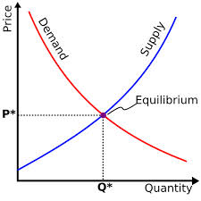
What is a Market?
Traditional Markets
Stock Markets
Bond Markets
Housing/Mortgages
Commodities – gold/silver etc
Crop Futures – corn/soybean
Consumer Credit
…
A market is one of the many varieties of systems, institutions, procedures, social relations and infrastructures whereby parties engage in exchange. Traditional markets are often regulated, have defined trading norms/rules, and have been in existence for some time.

Slide 4
Securities Trading can be distilled into 4 categories*
Belief Based – some intrinsic value of the company is appealing and triggers a buy/selling action.
“I like Netflix movies, so I bought Netflix.”
“I don’t agree with tobacco sales so I avoid those stocks.”
Warren Buffet “Buy companies you understand.”
Fundamental Trading - traditional financial indicator triggers an action regardless of sector, or company product.
“I reviewed Berkshire’s annual report and decided to buy based on EPS”
Technical Trading – trade based on “indications”. Uses non-financial mathematical indicators to quantify risk/reward, or trigger buy/sell
Momentum – Recognize prices moving up/down at thresholds to trigger action
“Charting” – Chart patterns trigger actions (crossovers, head & shoulders)
High Frequency Trading – Extremely technical trading and complex algorithms that can trigger thousands of actions measured in nano-seconds. “scalping” small profits thousands of times per minute.
* Keep in mind there are nuances & this is not a finance course.
This is my interpretation to make sense of complexity

Slide 5
What type?
Belief Based – some intrinsic value of the company is appealing and triggers a buy/selling action.
Fundamental Trading - traditional financial indicator triggers an action regardless of sector, or company product.
Technical Trading – trade based on “indications”
High Frequency Trading – “scalping” small profits repeatedly
The Stochastic Momentum Indicator (SMI), a formula for measuring momentum, crossed over to positive territory. I think I will buy Google (Alphabet).

Slide 6
What type?
Belief Based – some intrinsic value of the company is appealing and triggers a buy/selling action.
Fundamental Trading - traditional financial indicator triggers an action regardless of sector, or company product.
Technical Trading – trade based on “indications”
High Frequency Trading – “scalping” small profits repeatedly
Our PhD physicist wrote an algorithm that trades apple stock 10,000 per minute.

Slide 7
What type?
Belief Based – some intrinsic value of the company is appealing and triggers a buy/selling action.
Fundamental Trading - traditional financial indicator triggers an action regardless of sector, or company product.
Technical Trading – trade based on “indications”
High Frequency Trading – “scalping” small profits repeatedly
I won’t buy firearm companies.

Slide 8
What type?
Belief Based – some intrinsic value of the company is appealing and triggers a buy/selling action.
Fundamental Trading - traditional financial indicator triggers an action regardless of sector, or company product.
Technical Trading – trade based on “indications”
High Frequency Trading – “scalping” small profits repeatedly
In class we modeled the probability of risk using a decision tree and it looks like a buying a retail stock is a good investment.

Slide 9
What type?
Belief Based – some intrinsic value of the company is appealing and triggers a buy/selling action.
Fundamental Trading - traditional financial indicator triggers an action regardless of sector, or company product.
Technical Trading – trade based on “indications”
High Frequency Trading – “scalping” small profits repeatedly
Google’s quarterly ad revenue is improving, so I am going to buy some shares.

Slide 10
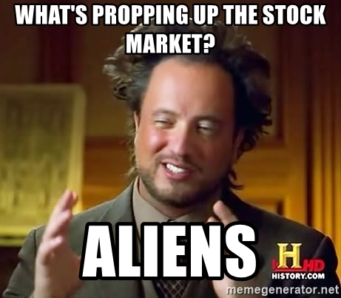
Financial Risk Modeling

Slide 11
Let’s zoom into Technical Trading Rules (TTR)
Our learning goal is to use and understand some of the common technical indicators which affect you as a saver, pension holder, stock trader etc.
Our learning goal is NOT to make you into a trader, or convince you that you are now qualified to be a technical trader.

Slide 12
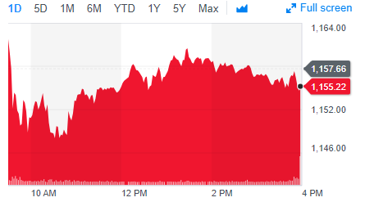
Stock Prices represent a time series
PRICE or Volume
TIME
BUT they are very hard to forecast due to external forces such as macro economic, international politics, sector/competitor actions, weather etc. From a forecasting perspective stock prices are often considered a “random walk” meaning traditional econometric forecasting techniques do not apply.

Slide 13
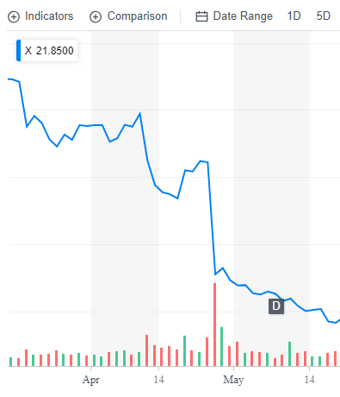
What happened to US Steel?
Daily Chart
4/25/17 Close : $31
4/26/17 Close: $22
4/26/17 Volume spike

Slide 14
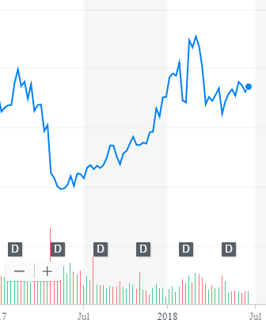
What other forces can impact US Steel?
Weekly Chart
After the disappointing quarter (self-inflicted) the stock rose dramatically. Why?
5/15/17: ~$20
2/26/18: ~$45

Slide 15
What other forces can impact US Steel?
Weekly Chart
After rhetoric of a trade war (international politics) with steel tariffs on their foreign competitors the price retreated and is now in a range. Why?
4/25/17: $31
4/26/17: $22
2/26/18: ~$45
4/16/18: ~$36
6/16/18 ~$36

Slide 16
What other forces can impact US Steel?
Weekly Chart
Now the trade war has shifted towards talk about auto tariffs, coupled with high auto inventory. Given trade and automotive inventory uncertainty, the range is likely to continue.
4/25/17: $31
4/26/17: $22
2/26/18: ~$45
4/16/18: ~$36
6/16/18 ~$36

Slide 17
So forecasting (pattern recognition) methods won’t work.
Weekly Chart
Some stock movements are self-inflicted (quarterly miss), others political (tariffs) while others are based on out of sector (automotive) performance.

Slide 18
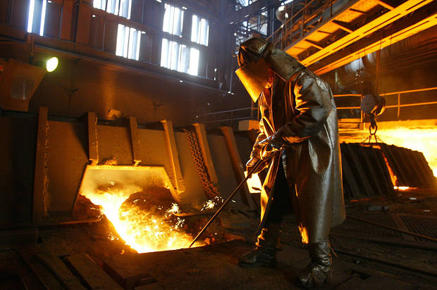
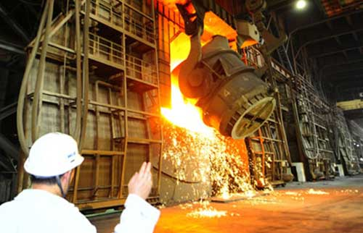

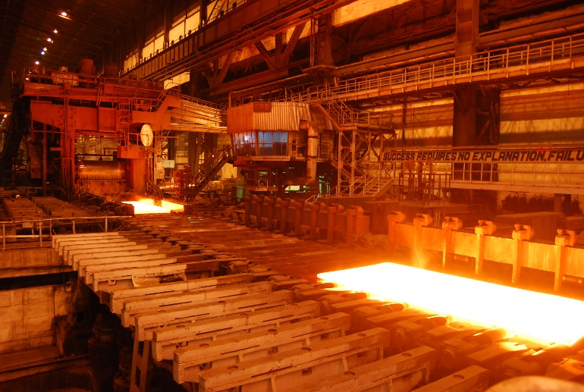
Meanwhile, US Steel was... producing steel.
Coincidentally, a belief investor would not have bought or sold but fundamental, technical and HFT would have been in and out at different times.

Slide 19
So instead of forecasting, can we identify indicators to move into or out of positions?
library(TTR)
SMA() #simple moving average
MACD() #moving avg convergence/divergence
RSI() #Relative Strength Index
For expediency we will cover 3 indicators but there are many more and you could even develop your own.

Slide 20
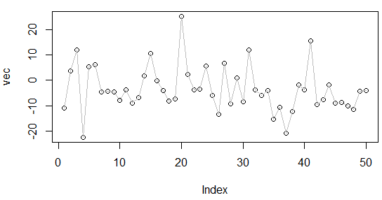
What is a moving average?
A smoothing technique reducing noise in a data series. Takes the average over “n” number of periods.
set.seed(1234)
vec <-rnorm(50,1,10)
plot(vec)
lines(vec, col='grey')
vec[1:15]
[1,] -11.070657
[2,] 3.774292
[3,] 11.844412
[4,] -22.456977
[5,] 5.291247
[6,] 6.060559
[7,] -4.747400
[8,] -4.466319
[9,] -4.644520
[10,] -7.900378
[11,] -3.771927
[12,] -8.983864
[13,] -6.762539
[14,] 1.644588
[15,] 10.594941

Slide 21

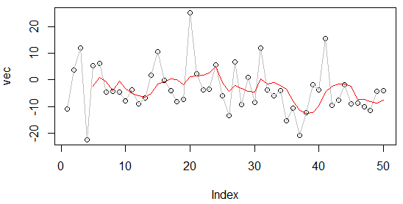
What is a moving average?
A smoothing technique reducing noise in a data series. Takes the average over “n” number of periods.
set.seed(1234)
vec <-rnorm(50,1,10)
plot(vec)
lines(vec, col='grey')
lines(SMA(vec, n=5), col='red')
vec[1:15]
[1,] -11.070657
[2,] 3.774292
[3,] 11.844412
[4,] -22.456977
[5,] 5.291247
[6,] 6.060559
[7,] -4.747400
[8,] -4.466319
[9,] -4.644520
[10,] -7.900378
[11,] -3.771927
[12,] -8.983864
[13,] -6.762539
[14,] 1.644588
[15,] 10.594941

Slide 22

What is a moving average?
A smoothing technique reducing noise in a data series. Takes the average over “n” number of periods.
vec[1:15]
[1,] -11.070657
[2,] 3.774292
[3,] 11.844412
[4,] -22.456977
[5,] 5.291247
[6,] 6.060559
[7,] -4.747400
[8,] -4.466319
[9,] -4.644520
[10,] -7.900378
[11,] -3.771927
[12,] -8.983864
[13,] -6.762539
[14,] 1.644588
[15,] 10.594941

Slide 23
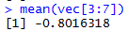
What is a moving average?
A smoothing technique reducing noise in a data series. Takes the average over “n” number of periods.
vec[1:15]
[1,] -11.070657
[2,] 3.774292
[3,] 11.844412
[4,] -22.456977
[5,] 5.291247
[6,] 6.060559
[7,] -4.747400
[8,] -4.466319
[9,] -4.644520
[10,] -7.900378
[11,] -3.771927
[12,] -8.983864
[13,] -6.762539
[14,] 1.644588
[15,] 10.594941

Slide 24
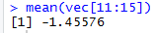
What is a moving average?
A smoothing technique reducing noise in a data series. Takes the average over “n” number of periods.
vec[1:15]
TTR::SMA(vec[1:15], n=5)
[1,] -11.070657
[2,] 3.774292
[3,] 11.844412
[4,] -22.456977
[5,] 5.291247
[6,] 6.060559
[7,] -4.747400
[8,] -4.466319
[9,] -4.644520
[10,] -7.900378
[11,] -3.771927
[12,] -8.983864
[13,] -6.762539
[14,] 1.644588
[15,] 10.594941
[1,] NA
[2,] NA
[3,] NA
[4,] NA
[5,] -2.5235367
[6,] 0.9027066
[7,] -0.8016318
[8,] -4.0637779
[9,] -0.5012865
[10,] -3.1396115
[11,] -5.1061087
[12,] -5.9534017
[13,] -6.4126457
[14,] -5.1548241
[15,] -1.4557603

Slide 25
Open 1_TTR_A.R

Slide 26
Open 1_TTR_B.R

Slide 27
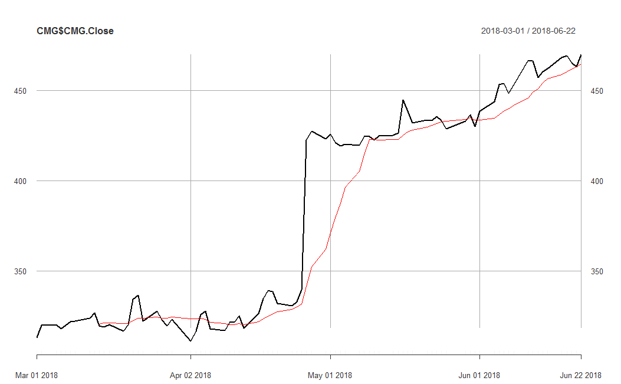
So how does SMA become an Indicator?
An investor can “backtest” the strategy to find an acceptable “n”. Once the best “n” is found, the SMA line represents points to buy and sell as the price crosses over.

Slide 28
So how does SMA become an Indicator?
Cross Over
Buy/Sell
From Investopedia:
Backtesting is the process of testing a trading strategy on relevant historical data to ensure its viability before the trader risks any actual capital. A trader can simulate the trading of a strategy over an appropriate period of time and analyze the results for the levels of profitability and risk.

Slide 29
Open 1_TTR_C.R

Slide 30
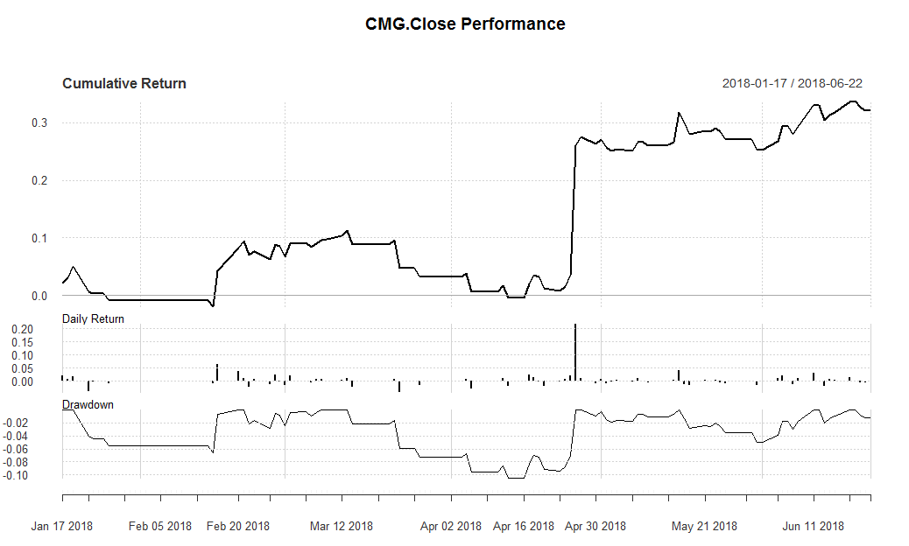
SMA as an Indicator for CMG
Total Cumulative Return using the rule.
Day to Day Return
Important if rule is sub one day periodicity.
Peak to trough % change, used to understand volatility.
Due to the price spike, ~20% of the total cumulative ~30% came in a single session. One could still argue the rule reduced risk because there were days without any capital exposure and the rule provided returns beyond the 1 day surge.

Slide 31
Moving Avg of Moving Avgs - MACD

Slide 32
Moving Average Convergence Divergence
The MACD stands for moving average convergence divergence indicator. By measuring the moving average of two moving averages with different time frames, an investor hopes to capture when momentum is building or receding.
Instead of “n”:
nFast(12) – the smaller window to measure (12 periods)
nSlow(26)- the longer window to measure (26 periods)
nSig(9)- the number of periods used to measure the avg difference “signal”
9 day Moving Avg (nSig) of
The difference between the 12 Moving avg (nFast) &
The 26 Moving avg (nSlow)
When MACD is positive, the price is accelerating, positive momentum/money is coming to the equity which represents a buying opportunity. Converse is true.

Slide 33
One small addition difference.
MACD uses exponential moving averages (EMA).
SMA
EMA
Each value in the “n” window has an equal weight.
Each value in the “n” window has an different weight. The weights decrease the farther back in time e.g. recent data is more relevant.
For example:
vec <-c(1,2,3,4,5)
mean(vec) #sum(vec)/5 i.e. 15/5
3
Advantage:
Faster to recognize a buy/sell signal.
Disadvantage:
More false signals, more sensitivity

Slide 34
Open 1_TTR_D.R

Slide 35
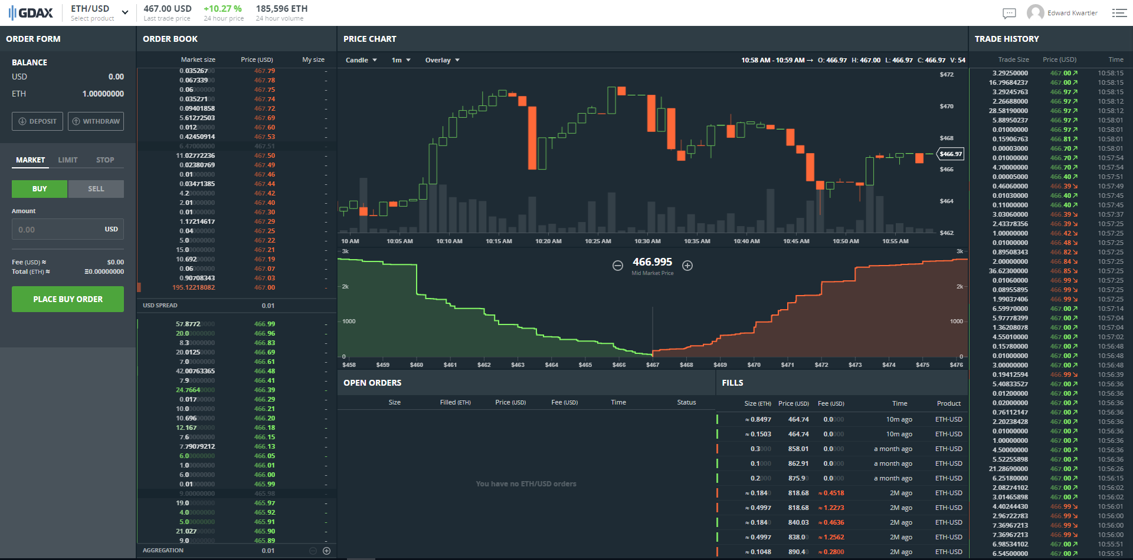
What about something more volatile?
How does the MACD hold up in an extremely volatile market?

Slide 36
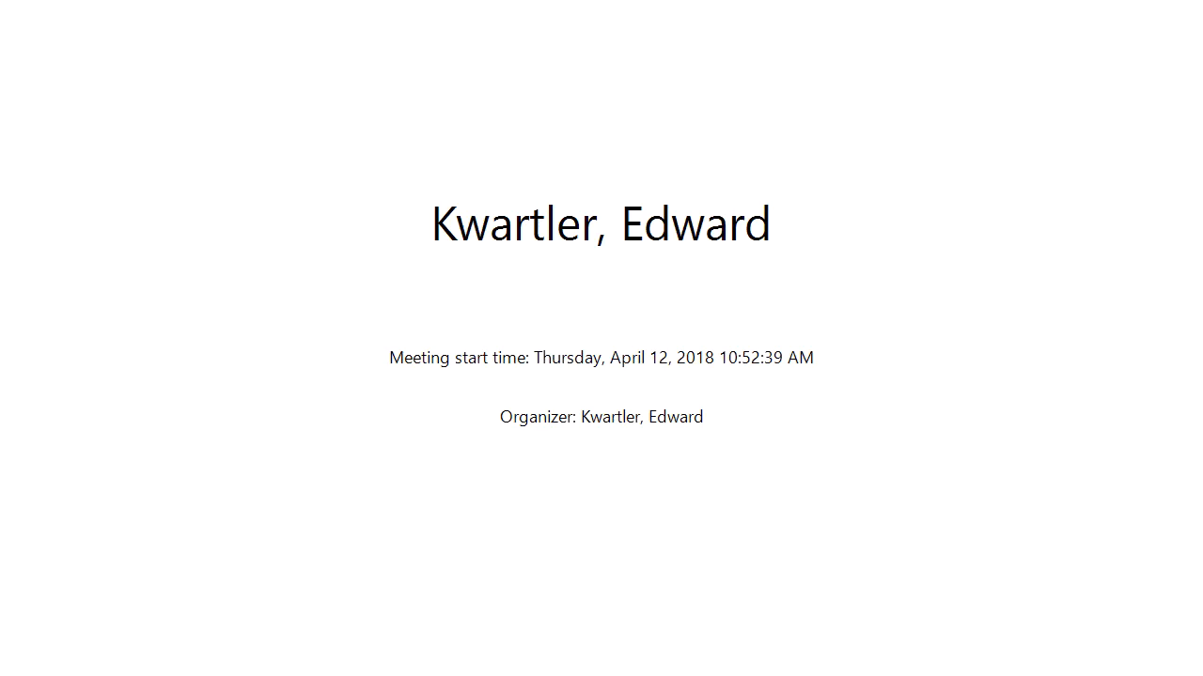

Slide 37
Open 1_TTR_E.R

Slide 38
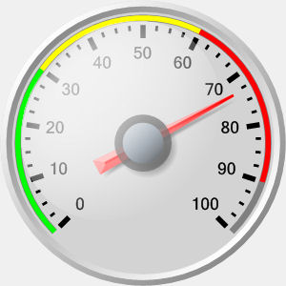
Relative Strength Index (RSI)
Momentum Oscillator
Index between 0-100
Compares average gains and losses in 14 day periods (“n”)
Usually interpreted as an overbought/oversold (over 70 / below 30)
* Usually uses EMA but we will do SMA.

Slide 39
Creates a control chart.
70
RSI
30
TIME
When the RSI dips below a threshold (30) the stock is considered “oversold” meaning the market has overreacted to something and RSI may indicate a buying opportunity. RSI greater than 70 indicates the market is over buying the stock so it may be good to exit your position.

Slide 40
Calculating the RSI
RSI = 100 - (100 / 1+RS)
Where RS:
RS = Avg Gain / Avg Loss
Avg Gain = For “up” days, total number of points up / number of “up” days
Avg Loss = For “down” days, total number of points down/ number of “down” days

Slide 41
Open 1_TTR_F.R

Slide 42
Agenda
Start | End | Item
 |  | Securities
 |  | Financial Risk Modeling
 |  | Non-Traditional Markets

Slide 43

Consumer Credit - Lending Club
US consumers apply for various loans and instead of banks providing funds, everyday consumers fund the loan by purchasing “notes” and receive the interest.
Peer to Peer funding for
Personal Loans
Auto Loans
Small Business Loans
Medical Loans
Everyday investors can accept the loan risk – making it a new banking distribution model
Consumer credit is a traditional market. There are defined inputs (credit score), consumer protections (usury laws), and established distribution (credit applications).

Slide 44
What’s the Risk?
Risk
Mitigation
Over exposure in a single loan
Diversify – Do not fund more than $25 on a single loan
Early payment reduces interest received
Monitor & re-invest monthly
Illiquid – notes are 36-60 months
Buy notes with 36m horizons
Default – debtors that stop paying
Model the probability of default

Slide 45
What’s the Reward?
Reward
Result
Interest is imposed by LC
Investors have no input to the amount
Usually lower rates for the applicant
Lower capital cost for debtor
LC takes 1% of interest
Reduces reward incentive for investor
Remaining interest is paid monthly to note holders.
Investors act as banks & receive consistent returns

Slide 46

Example
Erin decides to buy a car. Instead of a traditional loan she applies at LC.
Erin applies for a $10k car loan
LC assesses her creditworthiness & posts a $10k loan @ 6% interest on the investor site.
Trish & hundreds of other LC investors fund the loan in $25 increments called “notes”
Each month Erin pays her loan, LC takes 1% and the investors make 5% on their outstanding notes.

Slide 47
Data
11 yrs of historical performance – Over 1M notes publicly available
Some platform changes in that time
Datasets are updated monthly
Sampled to 20k – either in fully paid of charged off state
Loan Origination
36 or 60 Monthly Payments
Fully Paid
1 = Success Class
Transitional States of Nature:
Grace Period, 30-60,60-90 days
0 = Failure Class
Charged Off
https://www.lendingclub.com/info/download-data.action

Slide 48
Plan
We will model 0/1 probability of success (fully paid)
Methods
Artifacts
Cross Validation for stability of results
Rpart decision tree
Random Forest
Logistic Regression with CV
Compare results – Choose method & score new notes
Identify the most probable notes for being fully paid
Understand important variables
Visualize probability of success/interest rate (reward)
Depending on risk propensity, purchase X notes.

Slide 49
What is cross – validation?
Our previous partitioning schema had training, test and sometimes a holdout set.
Training Data
All Data
Test Data

Slide 50
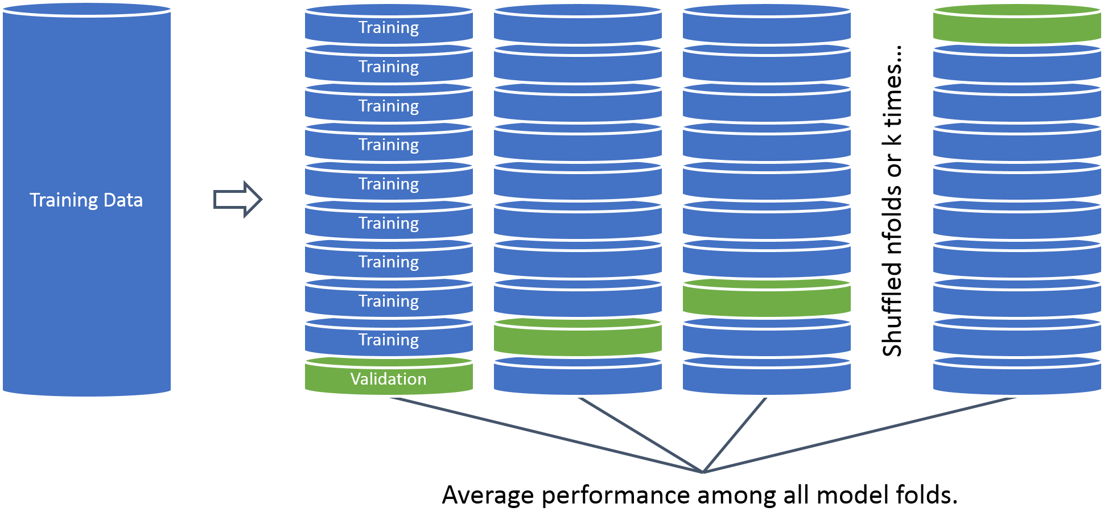
What is cross – validation?
Now we segment & rotate our data. This introduces a new tuning parameter & increases model training time.
Why would this be a good idea?

Slide 51
Open 2_CreditModeling_A.R
Let’s make a simple decision tree.

Slide 52
Open 2_CreditModeling_B.R
Let’s make a randomForest.

Slide 53
Open 2_CreditModeling_C.R
What about our old friend logistic regression?
We will perform variable treatment
We will cross-validate results
This gives the model an unfair advantage over the last two but should demonstrate how to the best model is often the most complex.

Slide 54
Cutoff Threshold
Is 0.50 the optimal cutoff?
Should we be equal weighted?
Do we care equally about picking paying notes and charged off loans?

Slide 55
The cost of getting it wrong is high!
Is 0.50 the optimal cutoff?
We have ample opportunity to pick high probability notes so it best to be precise, throwing out many hundreds of notes that are still likely to be paid fully.
Another example where adjusting the cutoff may be good.
Disease Detection? High or Low?
What if the idea is to save lives? What about saving costly medical test?
What other examples of non-50% cutoff could be appropriate?

Slide 56
Armed with our three algo’s let’s choose the best.
Open 2_CreditModeling_D.R

Slide 57
Time to buy some loans!
Open 2_CreditModeling_E.R
Open 2_CreditModeling_F.R
Now that we know CV GLM is best we won’t be making any a priori parameters changes, so we can model on 100% of the data.

Slide 58
Agenda
Start | End | Item
 |  | Securities
 |  | Financial Risk Modeling
 |  | Non-Traditional Markets

Slide 59
Non-Traditional Markets
Traditional
Non-Traditional
Stock Markets
Bond Markets
Housing/Mortgages
Commodities – Gold, Silver etc.
Crop Futures
Consumer Credit
Crypto-currencies
Beanie Babies
Derivatives (originally)
Web Domains
…
In contrast to traditional markets, emerging or non traditional markets lack transparency, regulations and can often be manipulated more easily.

Slide 60
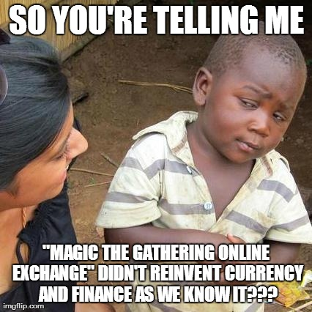

A non-traditional Market - Example
Owned by Hasbro, MTG is a 25 year old collectible trading card game. It is estimated that there are 8-12million players worldwide. Thus is it popular and has demonstrated longevity unlike other non-traditional markets.

Slide 61
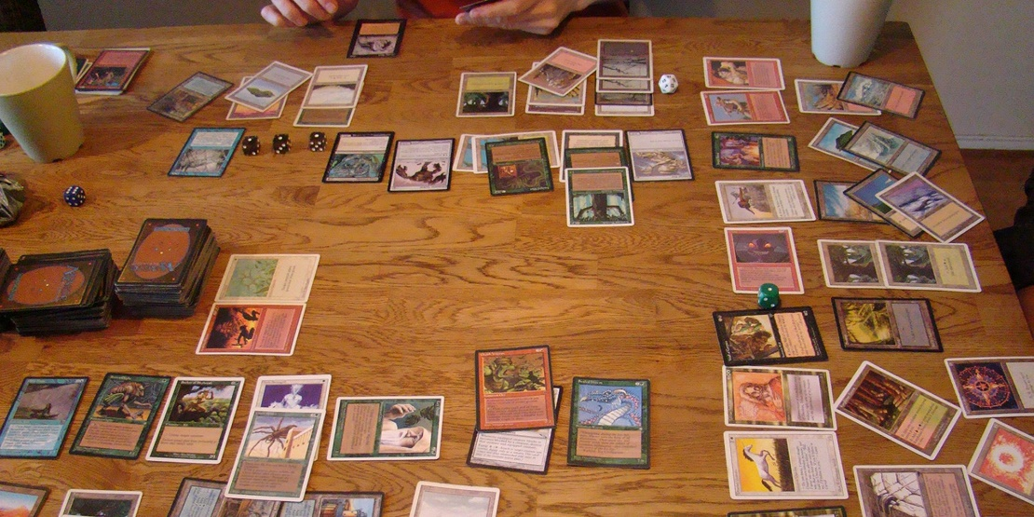
Magic The Gathering
Players create 60 card decks with cards of different abilities for a duel. Cards are fantasy based with creatures, sorceries, and mythical artifacts.
Cards are released in expansion sets with themes, such as vampires, dinosaurs or Egyptian. Further, cards have varying frequency, listed as “common”, “uncommon”, “rare” and “mythic.” Typically, the game play of the rare and mythic cards is more powerful.

Slide 62
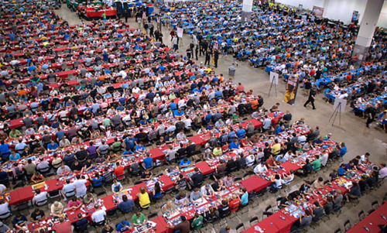

Magic The Gathering
Due to the popularity and the fact that rare cards are generally more powerful, players are willing to spend a lot of money to obtain the cards.

Slide 63
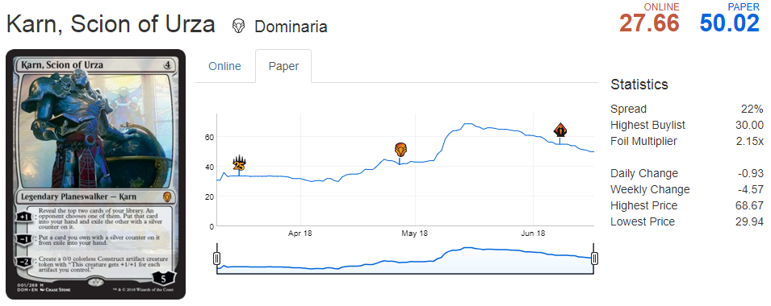
And that’s why it’s a market…
Karn, Scion of Urza is a popular card selling for ~$50 but has been as much as $65. Websites such as mtggoldfish.com and mtgstocks.com track prices on various market sites.

Slide 64
So how do you get cards?
Say you are a player that needs to get Karn, Scion of Urza to complete a deck.
For $50
You could buy Karn from an online marketplace.
For $3
You can open a booster pack from the appropriate expansion set and hope you get it.
For $90
You can buy a booster box of 36 packs from the set and increase your odds of getting it while also getting many other potential valuable cards.
For $540
You can buy 6 of the booster boxes in a case.

Slide 65
Limited Supply
Unfortunately, the set with Karn, Scion of Urza will not be printed after 2018 so supply could dry up. If the card remains popular prices could rise… So in the future the only way to get the card could be to:
For $75
You could buy it from an online marketplace.
For $6-10
You can open a booster pack from the appropriate expansion set and hope you get it.
For $100-150
You can buy a booster box of 36 packs from the set and increase your odds of getting it while also getting many other potential valuable cards.
With time, the fact the sealed product could contain one of the out of print cards means the prices include a “gamblers premium”.
As a result, sealed boxes are often sold for many thousands the older they get.

Slide 66
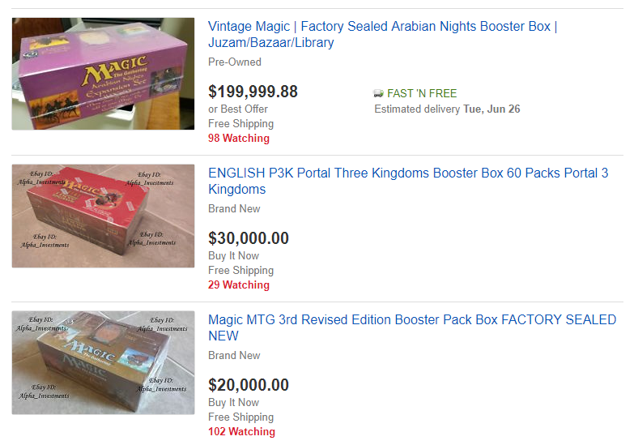
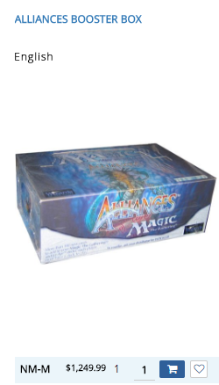
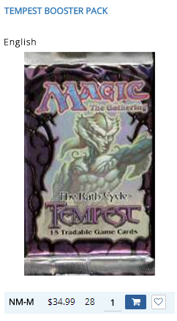
Sealed product costs for old sets is high.

Slide 67
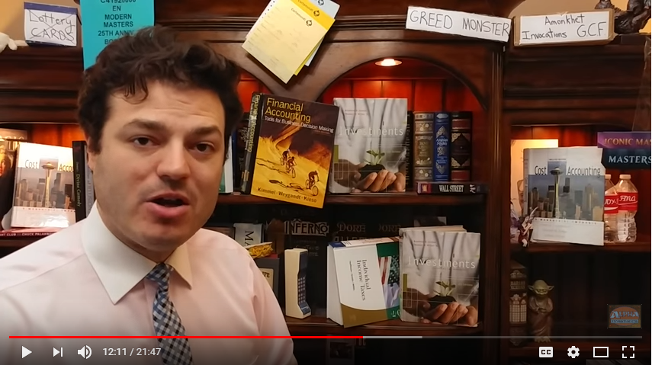
So, real investing and speculation occurs.
6:30 – 8:30
https://www.youtube.com/watch?v=9OnBQt-8ntk
* Apologies for the brief profanity. Please leave the room if you are offended this isn’t my content.

Slide 68
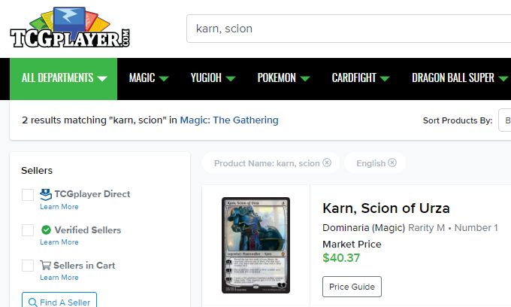
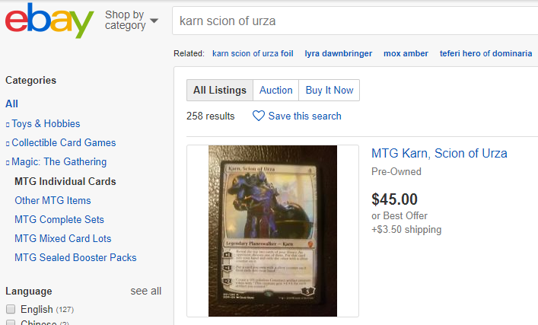
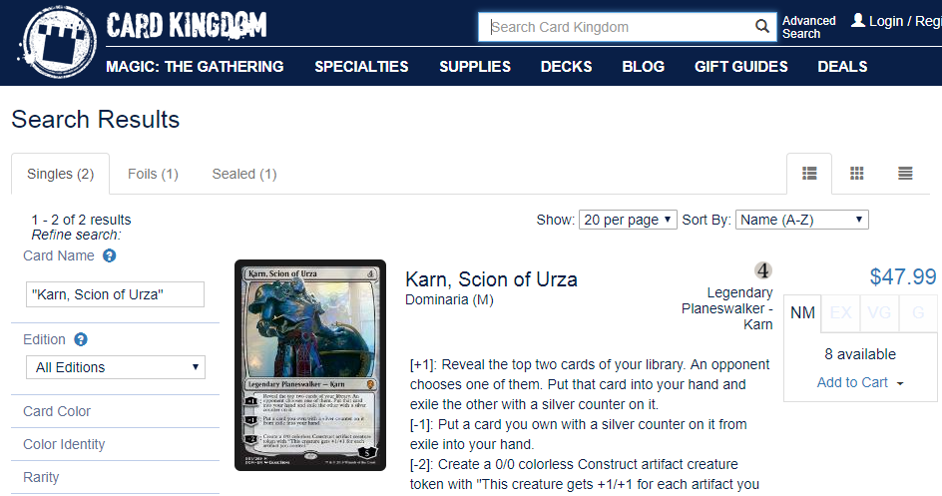
So where do market transactions occur?
Millions of USD each month transact based on card popularity in tournaments, game variations and pending reprints. In fact sometimes speculation on cards exists which can drive up prices dramatically.

Slide 69
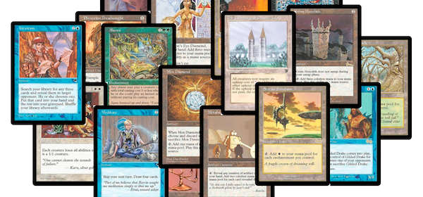
Making matters worse…
Hasbro’s subsidiary that publishes MTG, Wizards of the Coast, has an official reprint policy called “the reserved list.” The reserved list contains cards that were considered so powerful, they will not EVER be reprinted.
Many of the reserved list cards are old, and there are not many copies in existence.

Slide 70
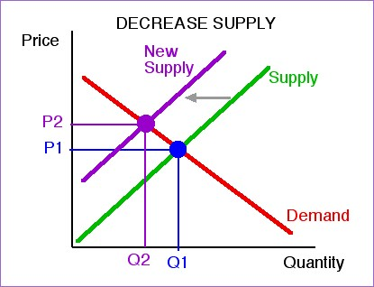
The reserved list…
The reserved list artificially reduces supply and virtually guarantees price stability in the future since the cards will not be reprinted. Further, as the game attracts new players, the demand curve shifts out.

Slide 71
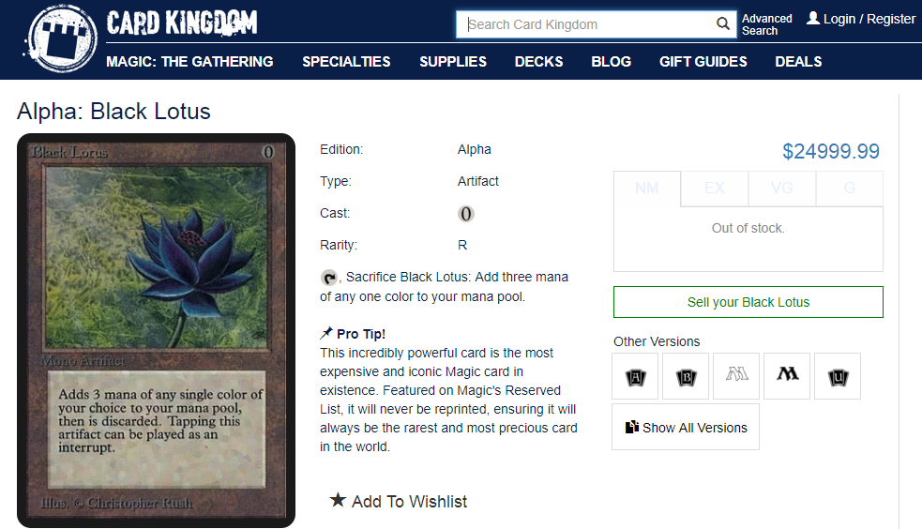
And that’s why it’s a market…to be manipulated
The most famous of the reserved list is the “Black Lotus”. Prices for this card range from $6500 to $25,000

Slide 72
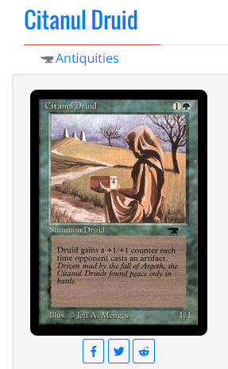
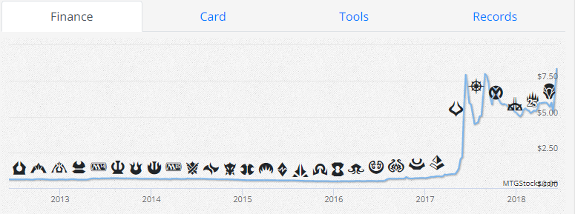
Reserved list buy out…
Over the course of two weeks I bought 14 copies of this card from $1-$5. In doing so, I was able to spike the price from $1 to $7. The price declined shortly there after and stabilized at $5 resulting in successful market manipulation. Additionally, others have purchased the card and the price is up to $19!

Slide 73
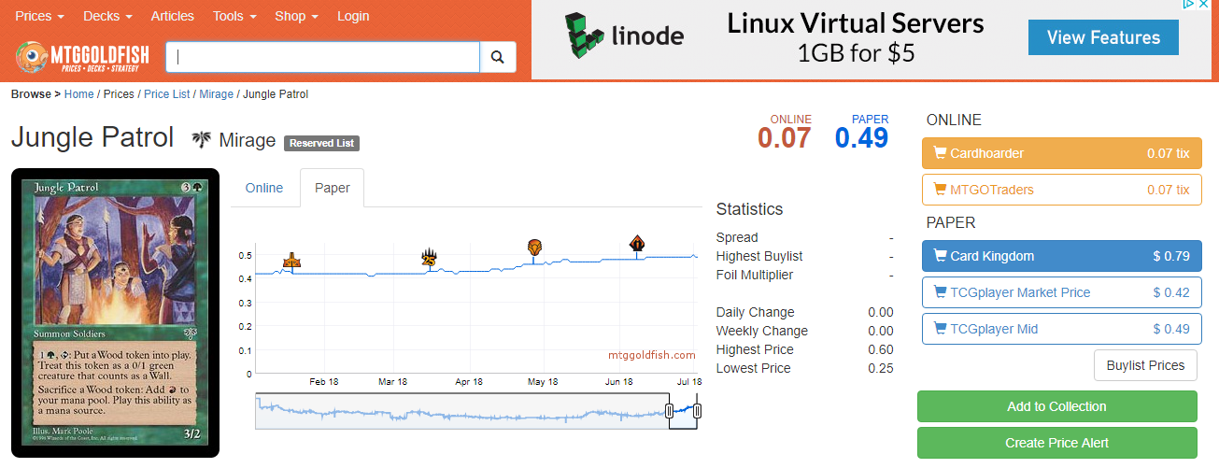
Reserved list buy out…FAILURE
I purchased ~100 Jungle Patrol cards for about $0.50 ea. The price has only gone up to .62 since purchasing late June. Mirage is an expansion set with millions more copies than the previous “antiquities” set.

Slide 74
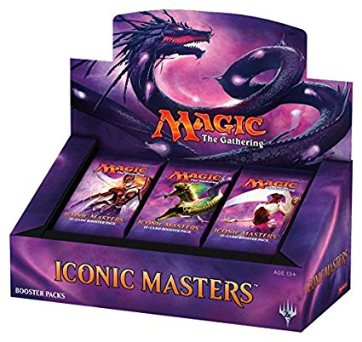
Regardless of the Reserved List
Newly printed cards are sold in 15 card packs.
Usually a pack contains
11 Commons
3 Uncommons
1 Rare
1 in 8 packs will replace the rare with a mythic
1 in 6 packs will have a random premium foil card replacing a common.

Slide 75
Modeling Risk/Reward outside of the Reserved List
When you open a pack:
Risk:
Each expansion set has varying prices. Some cards are worthless while other modern cards can be expensive (not reserved list prices though). You could buy a pack and receive nothing of value.
Reward:
Some packs will contain expensive cards which you can immediately sell for more than the cost of the pack.
Since we know the cards in a set, their prices, and the probabilities of getting specific cards, we can simulate pack openings.
*Keep in mind there are friction costs, shipping a physical good takes time and money.

Slide 76
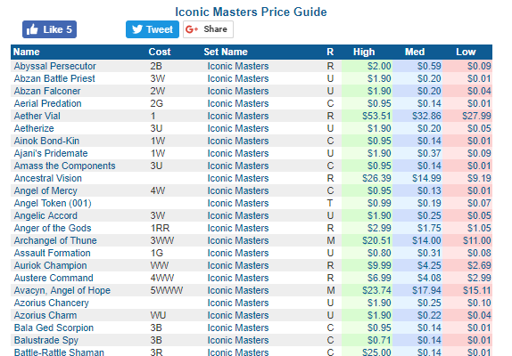
Custom Package Simulating Opening Packs & Boxes
http://magic.tcgplayer.com/db/search_result.asp?Set_Name=Iconic%20Masters
Iconic Masters
249 Cards
15 Mythic
53 Rare
80 Uncommon
101 Common
Every pack contains a foil card
Since we know the cards in a set, their prices, and the probabilities of getting specific cards, we can simulate pack openings.

Slide 77
For Example
Probability of a pack break down
To construct a pack:
Select 1 of 53 rare cards randomly
For 1 in 8 attempts, change the rare to be 1 of 15 mythic cards
Select 3 of 80 Uncommon cards randomly
11 of 101 Common cards randomly
Select 1 card in the pack to be foil.

Slide 78
Custom Package Simulating Opening Packs & Boxes
Get Set’s card and pricing information
1
Simulate opening a 15 card pack
2
Depending on rarity, and “foil” distributions are made with the H/M/L prices
3
Simulate 1000 pack openings to arrive at an average expected value.
4
$$$
No such thing as a bad set, only a bad price to pay for a pack, box or case.

Slide 79
Open 3_SimulateBoosters.R

